Slide 1



PYTHON PROGRAMMING
MOOCS ( 2ND PHASE)
AANCHAL SHARMA
BCA
20042100

Slide 2

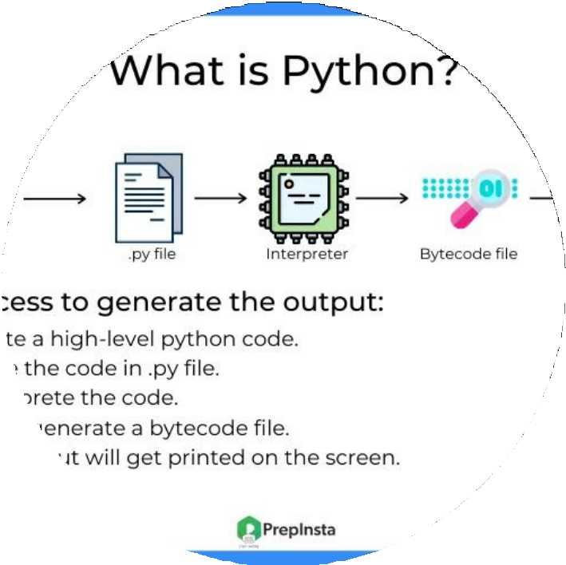

WHAT IS PYTHON
SALFORD & CO.
Python is an interpreted, object-oriented, high-level programming language with dynamic semantics.

Slide 3
ADVANTAGES
SALFORD & CO.
01
Free and Open-Source
02
Extensive library
03
Dynamically Typed
04
Portability

Slide 4

DISADVANTAGES
Speed Limitations
Not strong on type binding
Not easily converetible

Slide 5
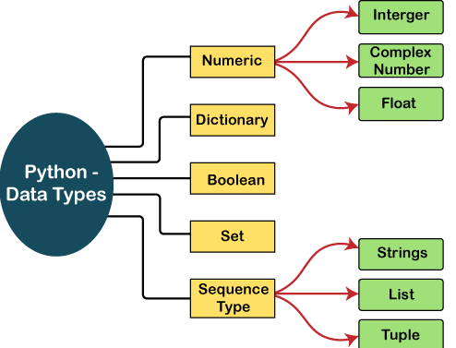
Python DATA Type

Slide 6
Python3 program to add two numbers
# Python3 program to add two numbers num1 =int(input( "enter the number:")) num2 = 12
# Adding two nos sum = num1 + num2
# printing values print("Sum of num1 and num2 is:"
,num1,num2)

Slide 7
LISTS AND TUBLES
LISTS
Lists are used to store multiple items in a single variable.
List Items
List items are ordered, changeable, and allow duplicate values.
List items are indexed, the first item has index [0], the second item has index [1] etc.
mylist = ["apple", "banana", "cherry"]

Slide 8
Tuples
Tuples are used to store multiple items in a single variable.
Tuple Items
Tuple items are ordered, unchangeable, and allow duplicate values.
Tuple items are indexed, the first item has index [0], the second item has index [1] etc.
A tuple is a collection which is ordered and unchangeable.
thistuple = ("apple", "banana", "cherry", "apple", "cherry") print(thistuple)

Slide 9

THANK YOU

